Slide 1


Slide 2
Bakery Sales Prediction Using Regression and Neural Nets

Slide 3
Project Team
Awais Akhtar
Yousra Abdrabou
Room: 5

Slide 4
Self Created Variables
day_of_week
is_saturday
is_sunday
sunshine_hours
public_holiday
school_holiday
is_next_day_holiday
month
Is_last_day_of_year
Notes:
Hot encoding and binary encoding

Slide 5
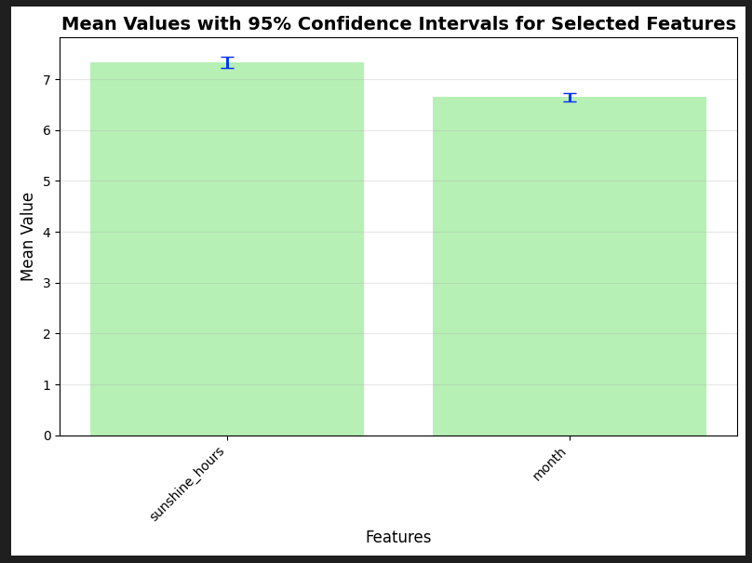
Self Created Variables
sunshine_hours (Mean = 7.3373, 95% CI = [7.2266, 7.4480])
month (Mean = 6.6494, 95% CI = [6.5711, 6.7276])
Notes:
Transition: After baseline (Linear) and strong tree model (XGBoost), we tested a Neural Network to capture non-linear effects.

Slide 6
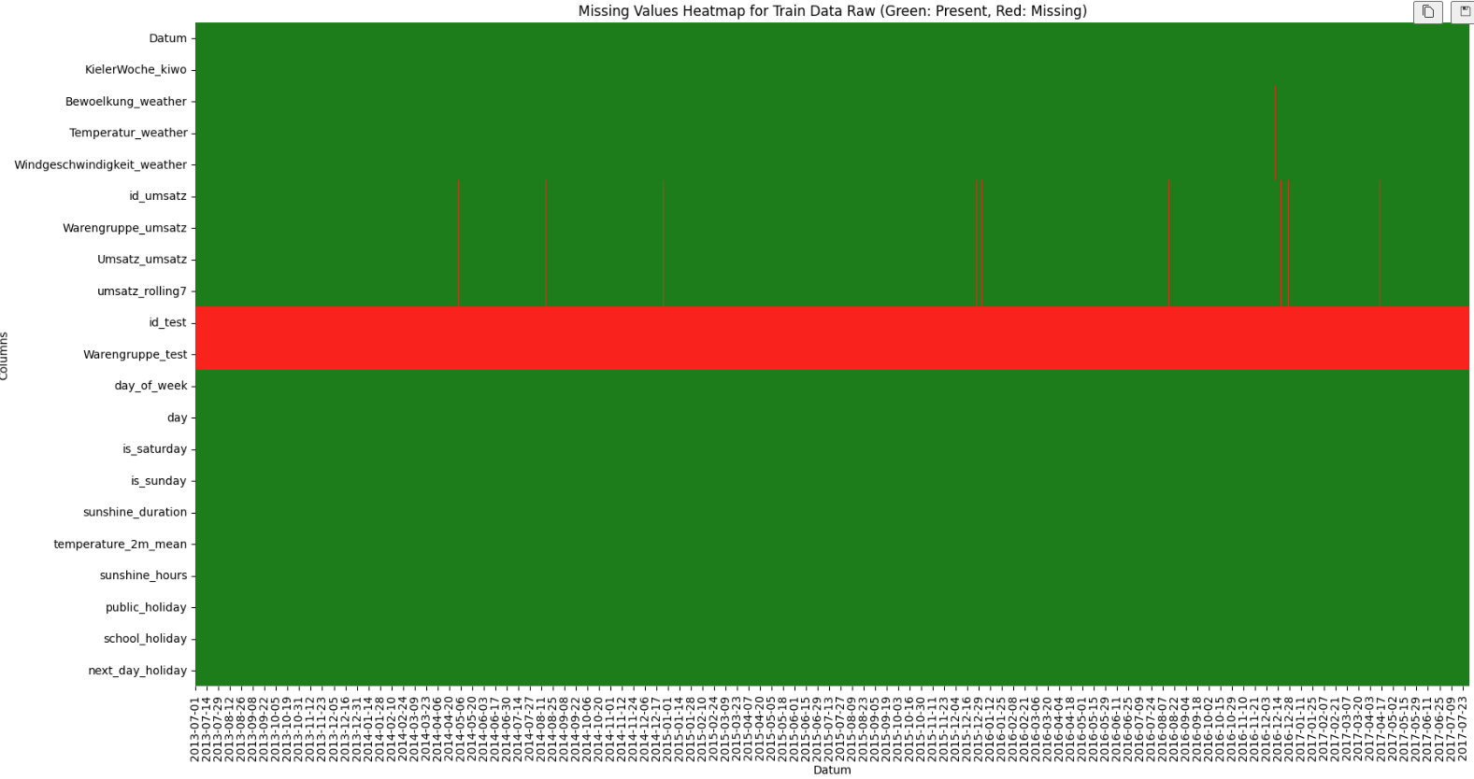
Missing Data
Notes:
Transition: After baseline (Linear) and strong tree model (XGBoost), we tested a Neural Network to capture non-linear effects.

Slide 7

Missing Data
Notes:
Transition: After baseline (Linear) and strong tree model (XGBoost), we tested a Neural Network to capture non-linear effects.

Slide 8
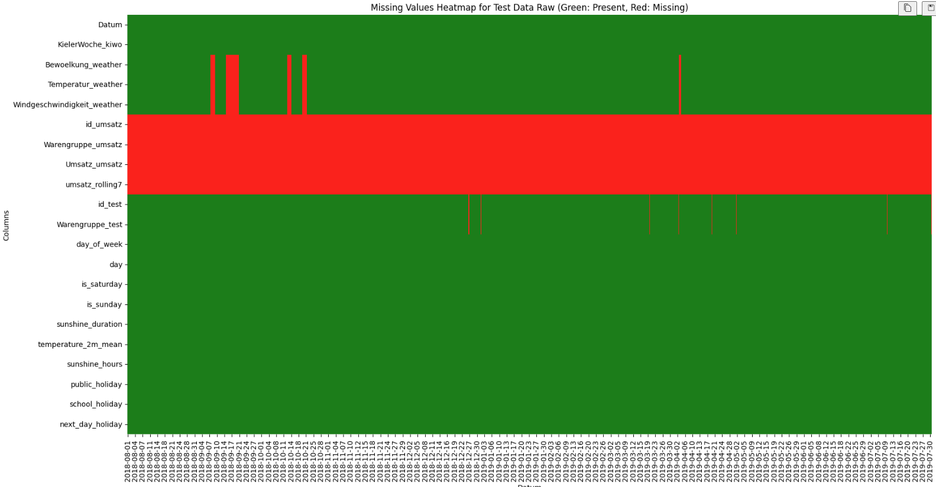
Missing Data
Notes:
Transition: After baseline (Linear) and strong tree model (XGBoost), we tested a Neural Network to capture non-linear effects.

Slide 9
Missing Data
Dropped weather_code
Linear Interpolation for missing data (temperature, cloudiness)
Notes:
Transition: After baseline (Linear) and strong tree model (XGBoost), we tested a Neural Network to capture non-linear effects.

Slide 10
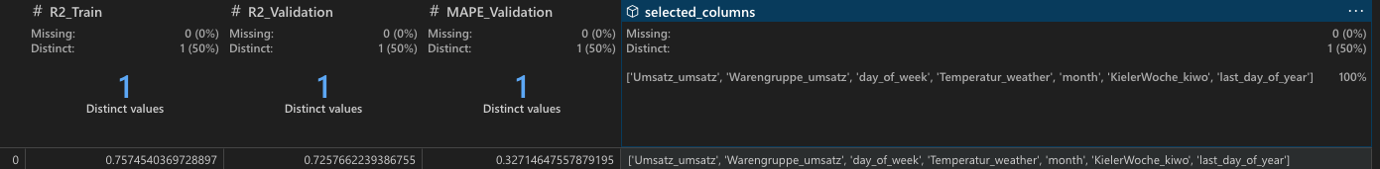
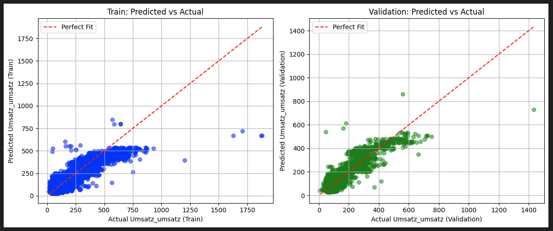
Linear Regression
Notes:
Transition: After baseline (Linear) and strong tree model (XGBoost), we tested a Neural Network to capture non-linear effects.

Slide 11
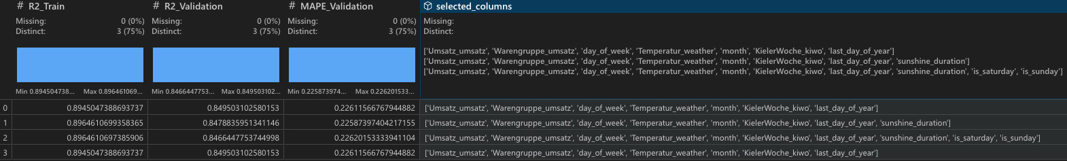
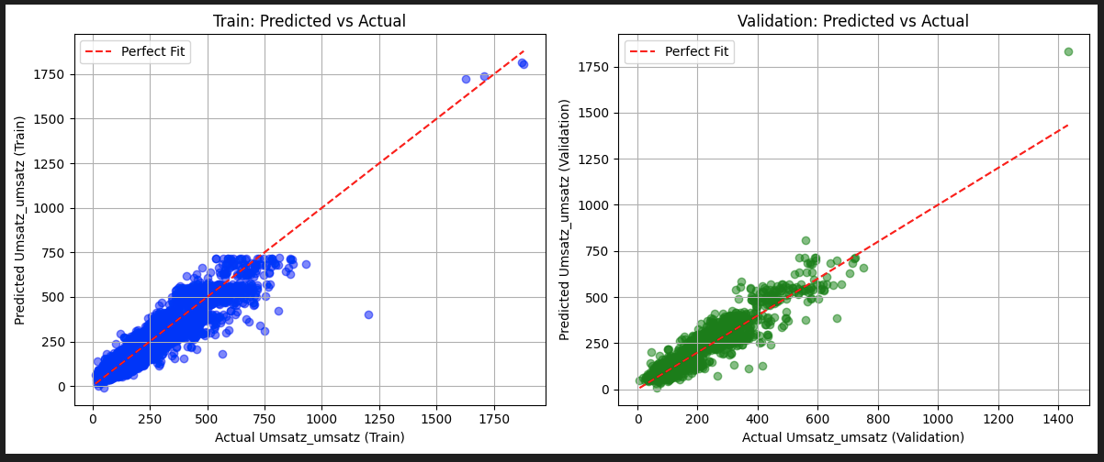
Linear Regression (Polynomial)
Notes:
Transition: After baseline (Linear) and strong tree model (XGBoost), we tested a Neural Network to capture non-linear effects.

Slide 12
Neural Nets – Motivation
Tested after Linear Regression.
Goal: capture non-linear relationships in Umsatz (sales)
Main evaluation metric: MAPE (same as Kaggle)
Notes:
Transition: After baseline (Linear) and strong tree model (XGBoost), we tested a Neural nets to capture non-linear effects.

Slide 13
Neural Nets Architecture
Input: preprocessed features (scaled numeric + one-hot product group)
Dense(64, ReLU) → Dense(32, ReLU) → Dense(1, Linear)
Optimizer: Adam (lr=0.001), EarlyStopping (patience=10)
Notes:
Explain ReLU in hidden layers and linear output for regression.

Slide 14
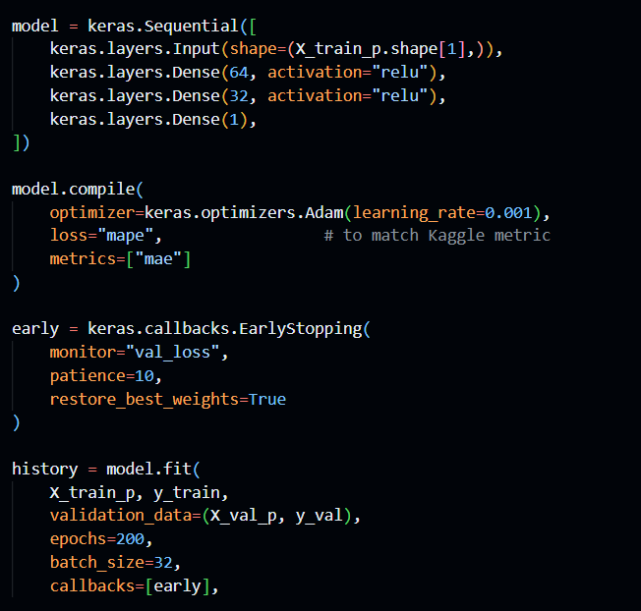
Neural Nets – Implementation
Notes:
Instructor requirement says 'screenshot of code'. You can keep this slide or screenshot this block from your notebook.

Slide 15
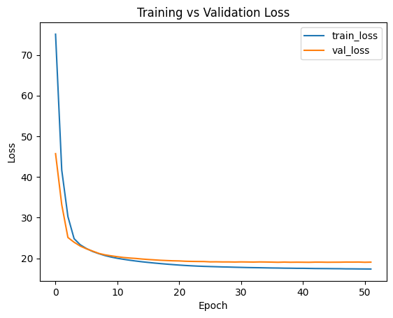
Training vs Validation Loss (MAPE)
Loss decreases for both training and validation
Early stopping selects best epoch (restore best weights)
Notes:
Point out no strong divergence between train/val -> limited overfitting.

Slide 16
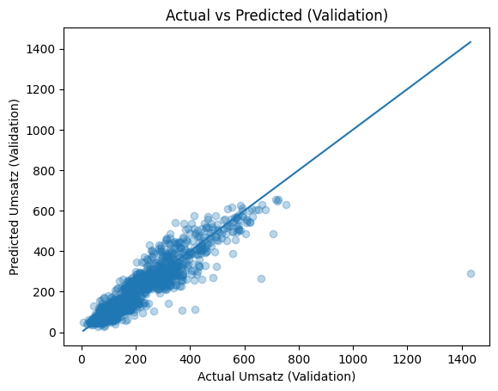
Actual vs Predicted (Validation)
Most points close to diagonal → good fit
Outliers remain → main source of high MAPE
Notes:
Use this to explain error distribution and why some days are difficult.

Slide 17
Neural Nets Optimization & Hyperparameters
Hidden layers: 64 → 32 neurons (ReLU)
Optimizer: Adam (learning rate = 0.001)
Batch size = 32, EarlyStopping patience = 10
Log-transform tested → no improvement (near-zero sales)
Removed rolling7 feature → improved validation MAPE
Instead of increasing model complexity, the main performance gains came from validation-driven feature and hyperparameter decisions, such as removing rolling features and tuning early stopping.

Slide 18
Validation Performance (Best Model)
Validation MAPE: 17.52%
Validation RMSE: 49.82
Validation R²: 0.8533
Notes:
Mention that predictions are clipped at 0 since Umsatz cannot be negative.

Slide 19
MAPE by Product Group (Validation)
Warengruppe_umsatz |  | MAPE_%
6 | Seasonal Products | 36.9580
4 | Confectionery | 21.9707
1 | Bread | 18.7823
3 | Croissant | 17.2352
5 | Cake | 14.0129
2 | Brötchen | 13.5508
Highest error group: 6 (MAPE 36.95%)
Lowest error group: 2 (MAPE 13.55%)
Group 6 (Seasonal) exhibits the highest MAPE, mainly driven by irregular demand patterns, limited observations, and the high sensitivity of MAPE when actual sales values are close to zero.
Notes:
Explain that product groups with more volatility / smaller values can show higher MAPE.

Slide 20
Baseline Regression vs Neural Nets
Model | Validation MAPE | Validation R²
Optimized Linear Regression | 0.2258 | 0.8495
Neural Nets (Final) | 0.1752 | 0.8533
Neural nets reduces prediction error by 22.4% (relative reduction in MAPE) compared to the optimized linear regression baseline.
Compared to the optimized linear regression baseline, the neural nets achieve a clear improvement in both MAPE and R².

Slide 21
Key Insights & Challenges
Neural nets outperforms regression baseline
Feature selection mattered more than model complexity
MAPE is sensitive to very low sales values

